Slide 1
Hannah’s Update
Results for Reduced number of cases on MIL and a patch classifier densenet model

Slide 2
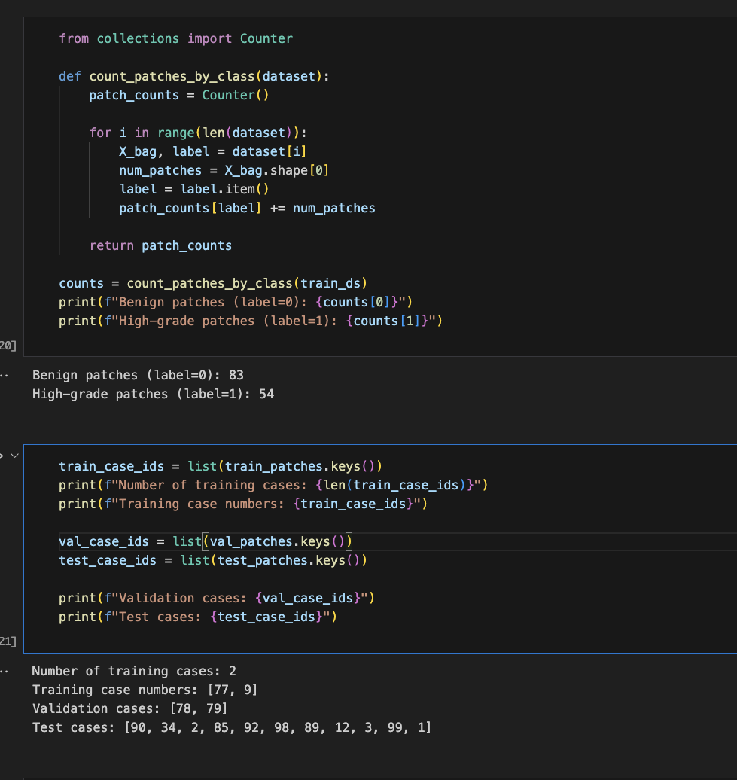
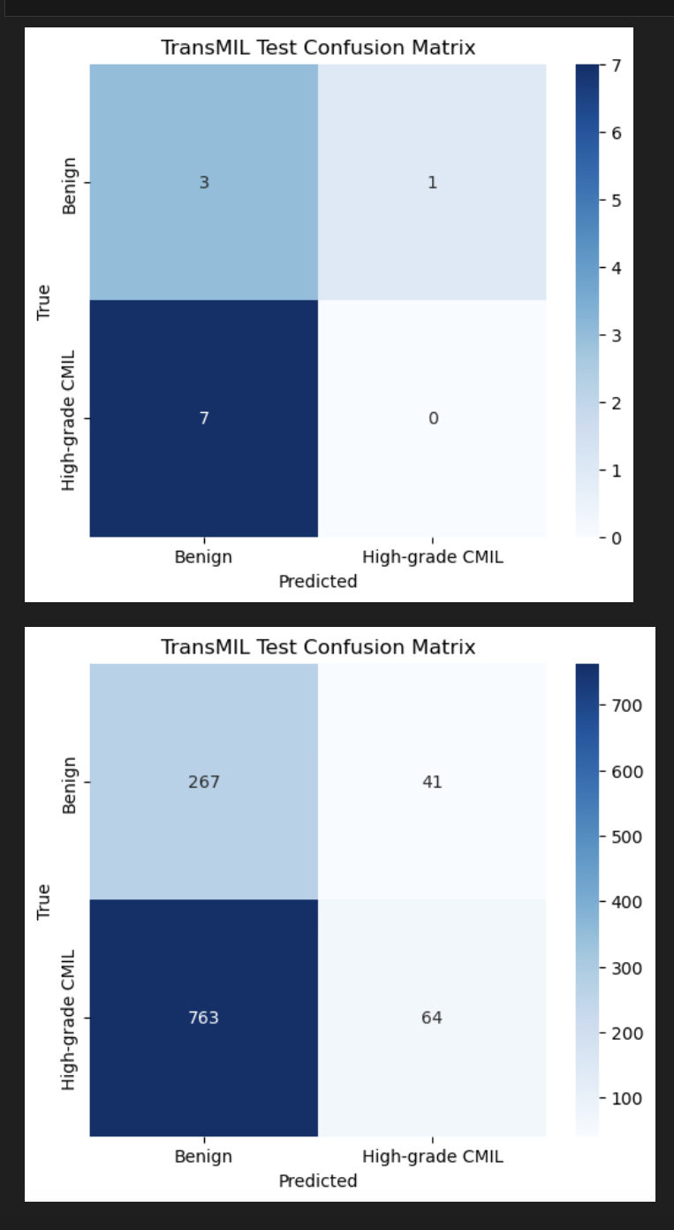
MIL Model Results
Notes:
I was initially exploring lots of more complex models like Multiple Instance Learning and even a transformer-based MIL that is basically an extension of the traditional MIL through using self-attention layers in order to model interactions between the patches within a bag (or case). However, when i realized that the kernel kept crashing and my model results weren’t good I transitioned to a simple MIL which is the basis to the TransMilL.
With the MIL I trained on only 2 cases, had 2 validation cases, and a number of test cases – however, as you can see there is still a clear class imbalance between the classes in terms of patches in the training, with much more benign patches. Then when I got the test results I also saw that the model was not performing well, predicting everything pretty much as benign.
So I realized I needed to change my approach. So first I needed to check if the backbone of the MIL model which is the patch classifier (which in my case I’ve been using densenet) is even learning patterns properly.

Slide 3
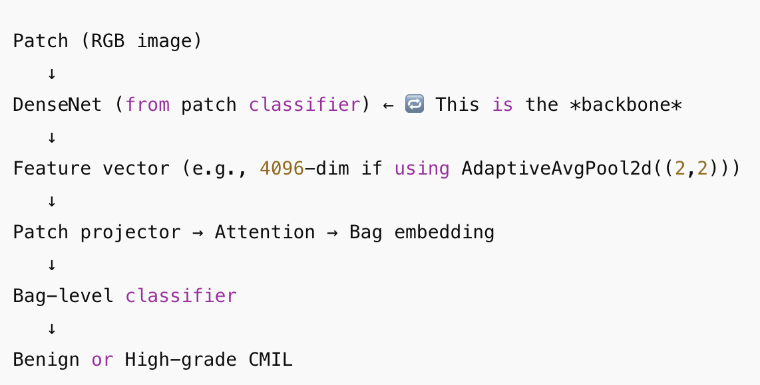
What is the backbone of the MIL?
Notes:
In MIL
You don't label each patch.
You only label the entire bag (case) — which is made of many patches.
But you still need features for each patch in order to decide how to aggregate them into a bag-level prediction
That's where the pretrained DenseNet comes in, and this is the backbone of the MIL
So we reuse the trained DenseNet feature extractor to embed each patch into a feature vector — instead of raw pixels — before attention or pooling layers make a final bag-level decision.
So By using a pretrained DenseNet from a well-performing patch classifier, you ensure that:
The patch features are already informative (e.g., they capture tumor structure, texture, etc.)
The MIL model doesn't need to re-learn what a “useful” patch looks like from only case-level labels
The attention mechanism can focus more on selecting important patches, not discovering all low-level features from scratch

Slide 4
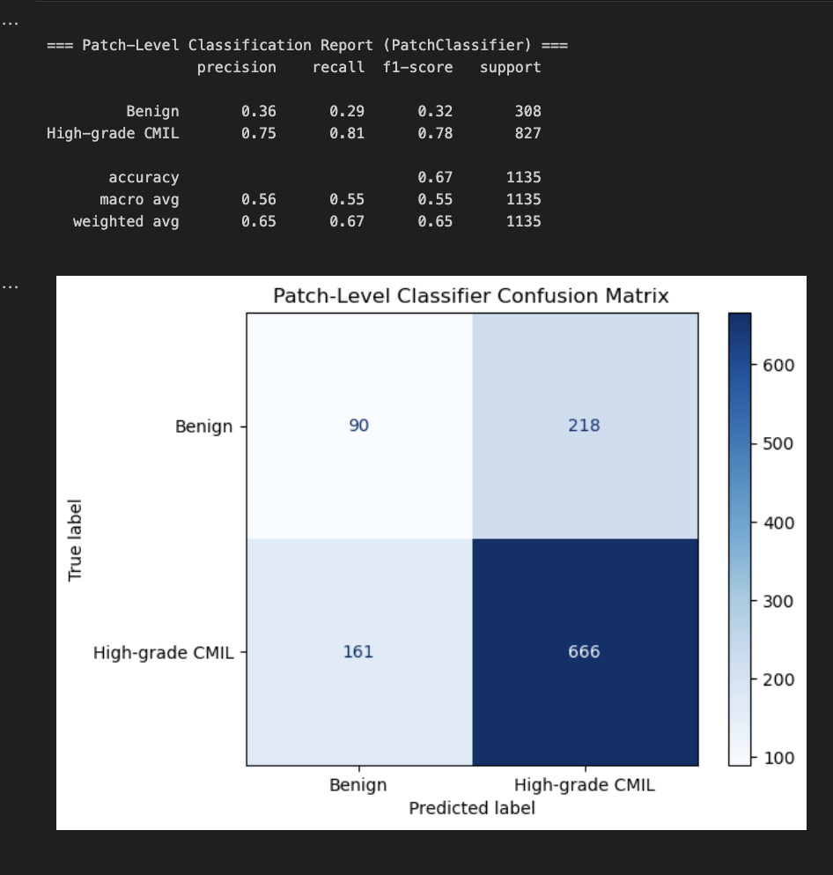
Initial Results (Patch Level Classifier)
Notes:
So on the same splits that I used before, which is pretty imbalanced, we see that we get about 67% but it’s only because the model is predicting everything as high grade.
So i realized I had to first address this issue before doing anything else.

Slide 5
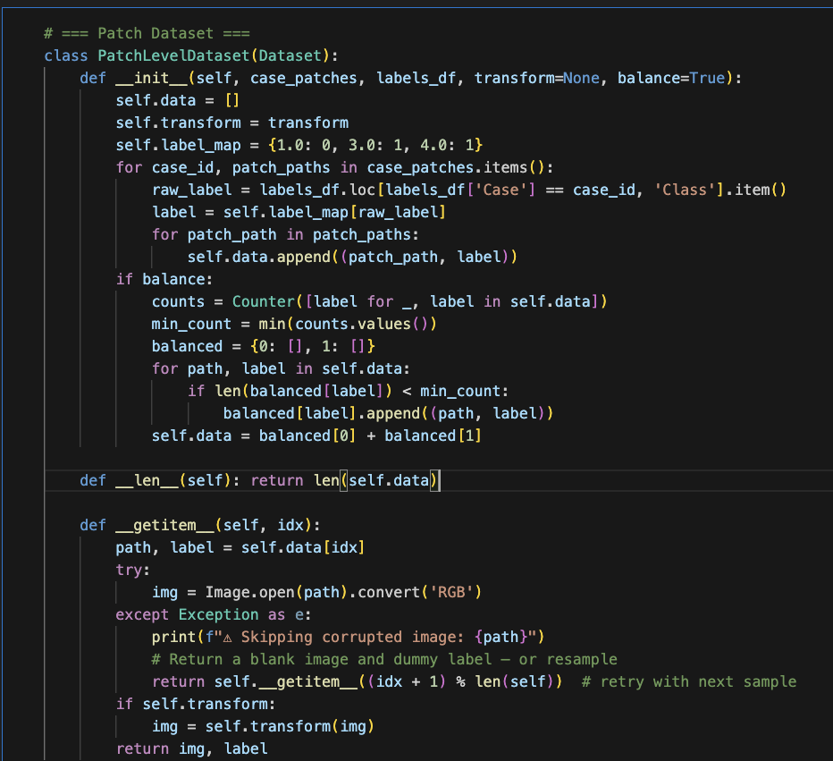
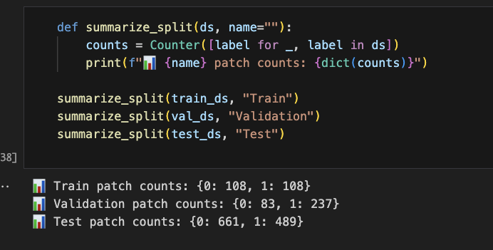
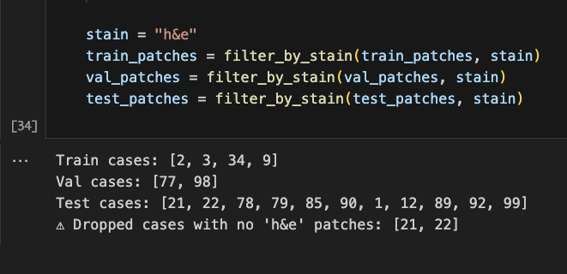
Trained Densenet Model w Curated Case #s
Notes:
So I basically forcefully balanced the classes by writing into the training of my patch classifier
What this does:
It loads all patches from the cases you selected.
It counts how many benign (label 0) and high-grade (label 1) patches exist.
It then downsamples the larger class so both classes have exactly min_count patches.

Slide 6
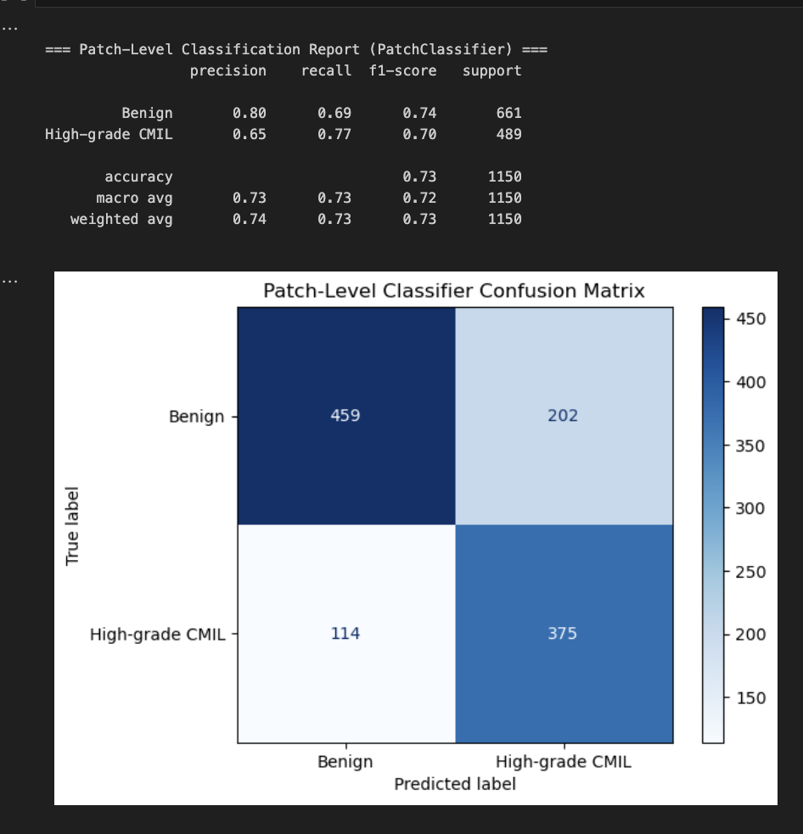
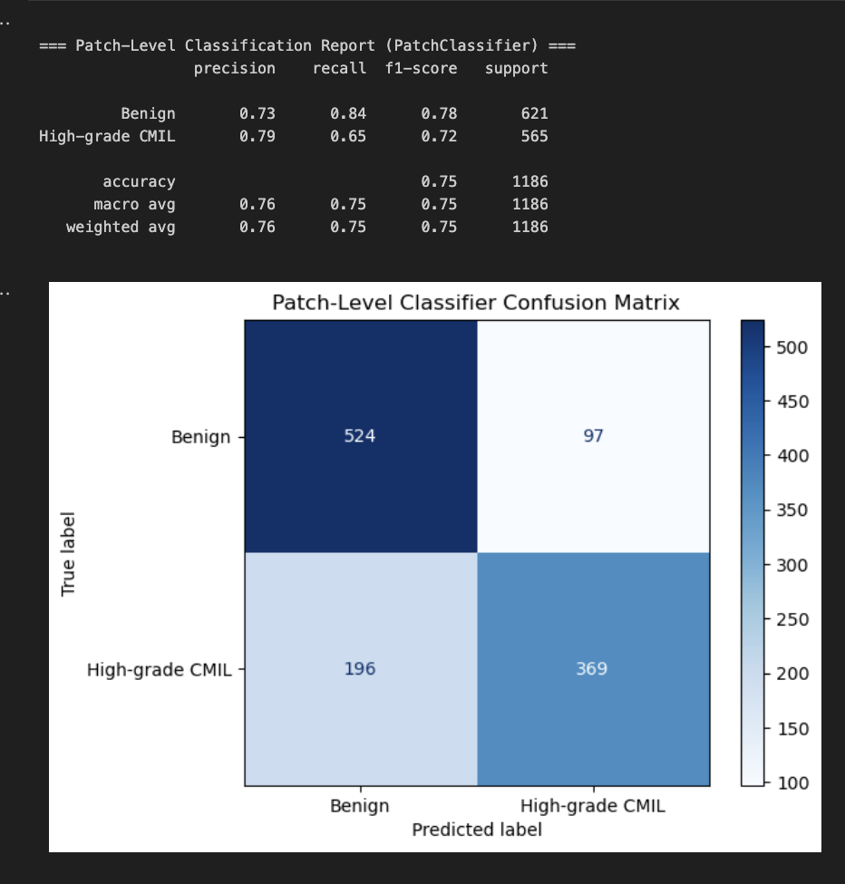
Trained w 5 epochs Trained w 10 epochs
Notes:
Made a big difference, because the model is finally predicting an accuracy of 73% not because it’s just consistently predicting one class, but because it has actually learned certain patterns. After training with 10 epochs, it reached a 75% accuracy.
Since now, I can be confident that the patch level classifier is actually learning features and patterns, I wanted to implement it back into the MIL.

Slide 7
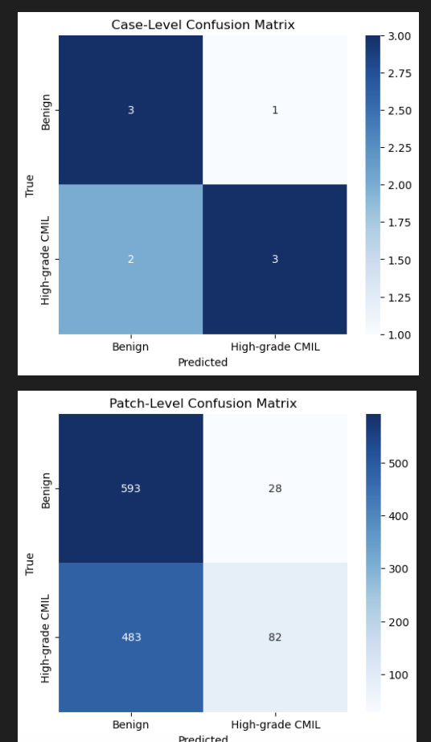
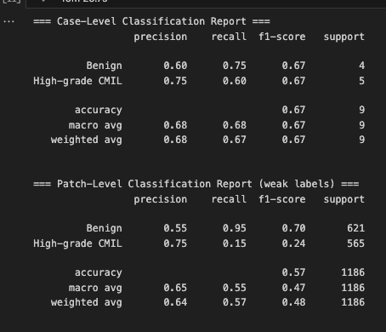
Notes:
My original MIL model predicted almost everything as one class—no clear learning. My improved MIL model, however now uses our pretrained DenseNet patch-level backbone, and it’s
Actually differentiating between classes at the case level (i.e. making reasonable predictions),
However, what is very interesting is that we see that it is struggling at the patch level—misclassifying many high-grade CMIL patches as benign, but still producing correct case-level predictions in those scenarios.
This is the exact behavior that MIL is designed to handle: Cause we don’t expect every patch in a high-grade CMIL case to look high-grade, but you do expect at least some patches to show those high-grade features.
MIL learns to weigh patch importance, So when the case is correctly predicted as high-grade CMIL despite many benign-looking patches, it shows that the attention mechanism I’m using in MIL is working, and that my model is learning that it doesn't need all patches to scream "high grade" to predict a high-grade case.

Slide 8
Conclusions and Next Steps
Takeaways:
Confirmed patch-level backbone is learning, but not sufficient alone
Attention in MIL may not be focusing enough on critical high grade patches
MIL is worth continue exploring
Next Steps
Strengthen attention mechanism
Explore positional information for patches (adding spatial positional encodings)
Use more training data (balanced)
TransMIL
Notes:
The biggest takeaways this week was that: Patch-level backbone improvements helped but may not be sufficient alone (seen in how the results in the MIL still predicted only 3 out of the 5 high grade cases correctly). Furthermore, the attention mechanism I’m using in MIL, while helpful, may not be focusing sharply enough on the few critical high grade patches within a bag. Some high-grade CMIL cases may be dominated by benign-looking patches, making them harder to identify under simple MIL aggregation.
So I hope to strengthen my attention mechanism (increasing the depth of my attention network, explore multihead attention, and potentially even spatial positional encodings), use more training data (balancing them of course), and also further now incorporate these steps into TransMIL.(Transformer Encoder: uses multi-head self-attention, so it would learn inter-patch relationships, not just per-patch importance)
For attention I currently have
a two-layer fully connected (MLP = Multi-Layer Perceptron) attention network that maps each patch embedding (vector) into a single scalar weight — its importance in the bag.
1 linear layer
1 non linear layer
Non linear activation function Tanh
Tanh outputs values in the range [-1, 1], which is zero-centered.
Unlike ReLU which only outputs non-negative values, Tanh allows both positive and negative activations, leading to more nuanced attention weight distributions after softmax.
1 more linear layer
Softmax
Normalize the weights so that the attention weights sum to 1.
Each patch embedding is multiplied by its attention weight
All are summed to create a single bag embedding

Slide 9
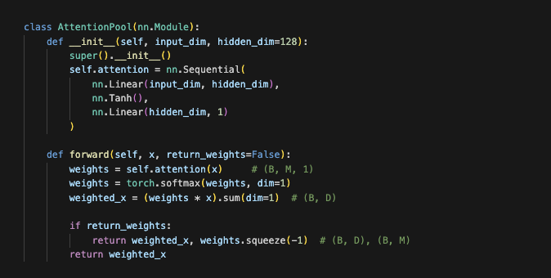
Attention in MIL
Notes:
🔍 What is Attention in MIL?
In the context of MIL, attention allows your model to:
Assign a learned importance weight to each patch (instance) in a bag (case).
Learn which patches contribute more to the overall classification, rather than assuming each patch contributes equally (as in average pooling), or only the best one matters (as in max pooling).
The model learns to “look” more closely at certain regions, even if only a few patches show high-grade features
What I’m doing here:

